Slide 1
End Behavior
Notes: 9/10

Slide 2
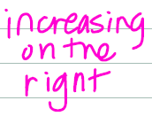
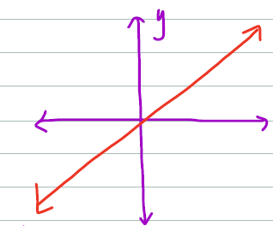
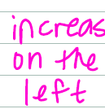


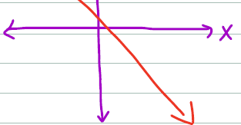

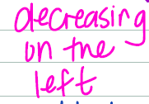
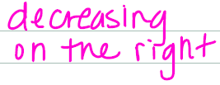
Uhhh, what is end behavior?
The end behavior of a function describes what happens to the function as x approaches and .

Slide 3

So what’s the final answer?

Slide 4
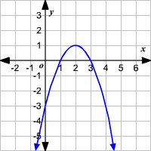
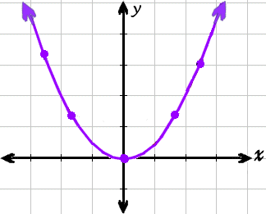
Determine the end behavior of the following:
a) b)

Slide 5
Remember…
These are just examples, not every function looks like this!
Fill in the End Behavior of each graph on the parent function table.

Slide 6
INtercepts
X-intercept: the point(s) where the graph crosses the x-axis
y-intercept: the point where the graph crosses the y-axis
To find the x-intercept, plug in zero for y and solve
To find the y-intercept, plug in zero for x and solve

